Slide 1
生醫量測系統設計 Design of Biomedical Measurement Systems
LAB 1
ECG&PPG signal extract

Slide 2
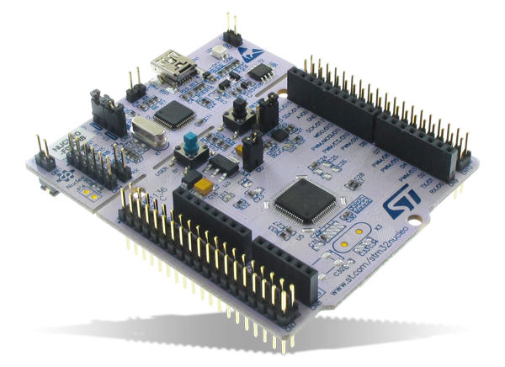
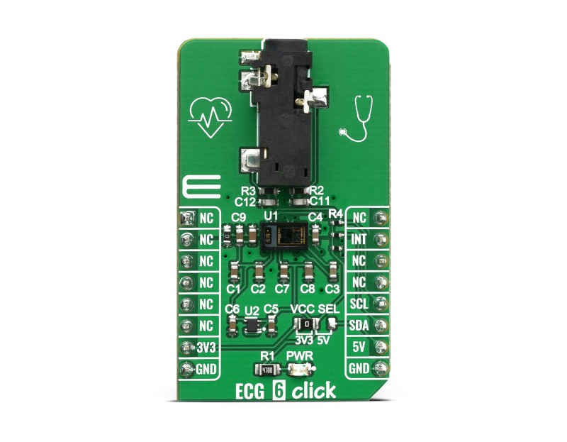
Hardware
The hardware used in this project is as below.
1. ECG 6 click 2. NUCLEO-F401RE
Notes:
這堂課第一個assignment我們會用到xxx和xxx板子，左邊這塊可以讀取ECG訊號也可以讀取到PPG訊號，稍後會在介紹什麼是ECG和PPG

Slide 3
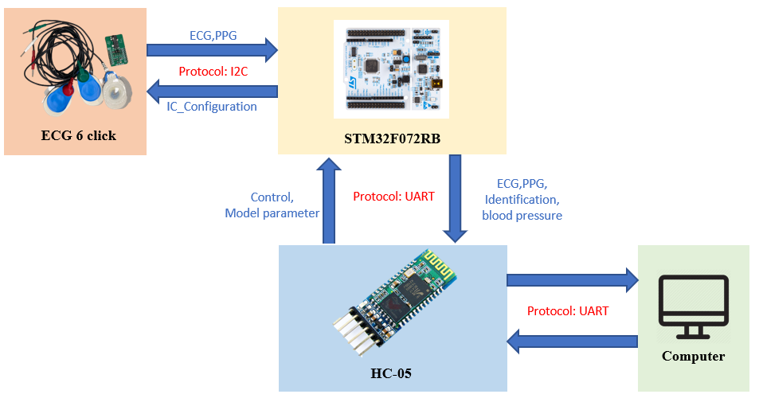
System Architecture

Slide 4



Development Environment
STM32CubeIDE
ANACONDA
VsCode
Notes:
會使用到的工具

Slide 5

Development Environment
Code Generation and Compile and Burn
Build Virtual Environment
Code Editor
Notes:
虛擬環境為什麼需要

Slide 6
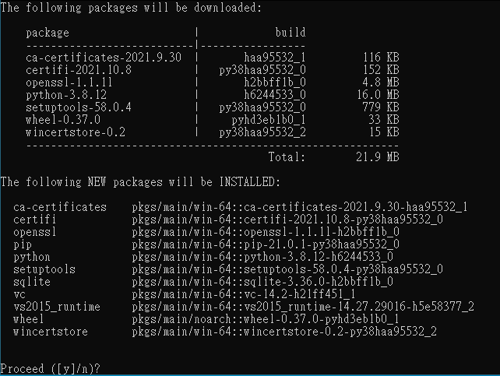
ANACONDA
Build Environment
conda create --name python38 python=3.8
Enter y to proceed

Slide 7
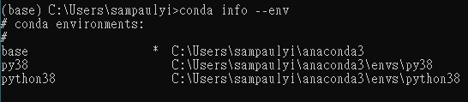
ANACONDA
Build Environment
conda info --env (you will see the python38)
conda activate python38 (base will change to python38)

Slide 8
ANACONDA
After entering the virtual environment, enter the following command to complete the module installation.
pip install scikit-learn
pip install pyserial
pip install numpy
pip install PyQt5
pip install matpltlib
After entering the command, you will receive a message as below.

Slide 9
ANACONDA
Use “cd” command to enter the directory.
Use “python” command to execute the python code.

Slide 10
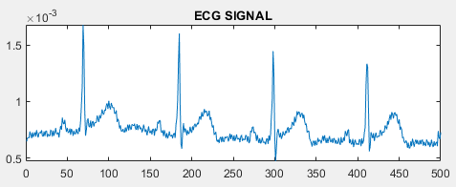
Electrocardiography
Electrocardiography(ECG) is a graph of heart electrical signals. In this project, we will use lead 1.
You can get lead 1 ECG by placing electrodes on the left arm, right arm, and left foot.
Notes:
根據Lead 1規則後面會再做詳細介紹

Slide 11
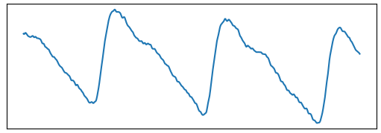
Photoplethysmography
Photoplethysmography(PPG) is a method to measure the blood volume in blood vessels. We can use LED and photodiode to obtain the signal.
Notes:
光積體變化描技法（Photoplethysmography，簡稱PPG）是一種非侵入性的方法，用於檢測組織微血管中的血容量變化。通常用於監測心率和其他生命體徵。基本的設置包括將光線照射到皮膚中，並測量經過或反射的光的量來得到生理訊號
非接觸式RPPG實驗室得東西有興趣可以稍後來問

Slide 12
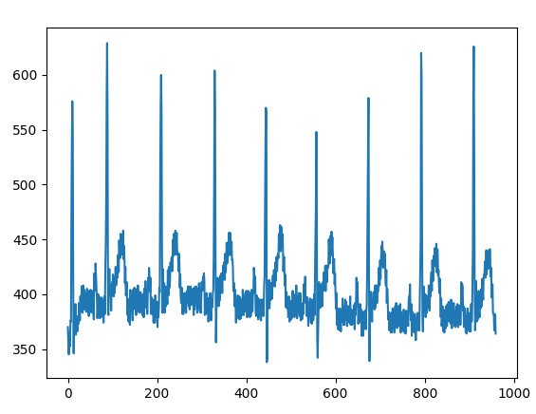
Data Preprocessing
After receiving the data from MAX86150, the data needs to be processed first. This step calls “preprocessing”.

Slide 13
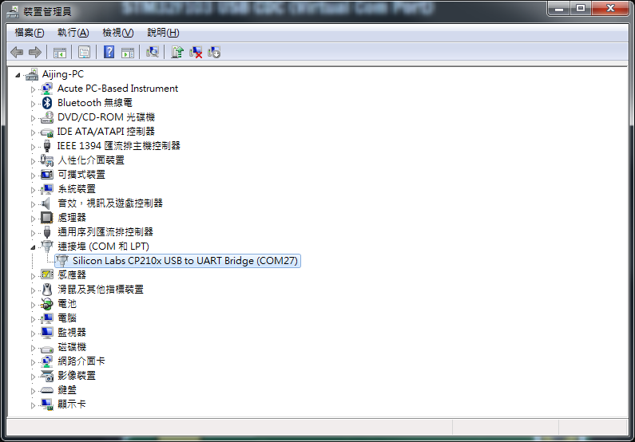
COM port
Directly connect using USB
From 'Control Panel' to 'Device Manager'
Locate 'Ports (COM & LPT)' and check

Slide 14
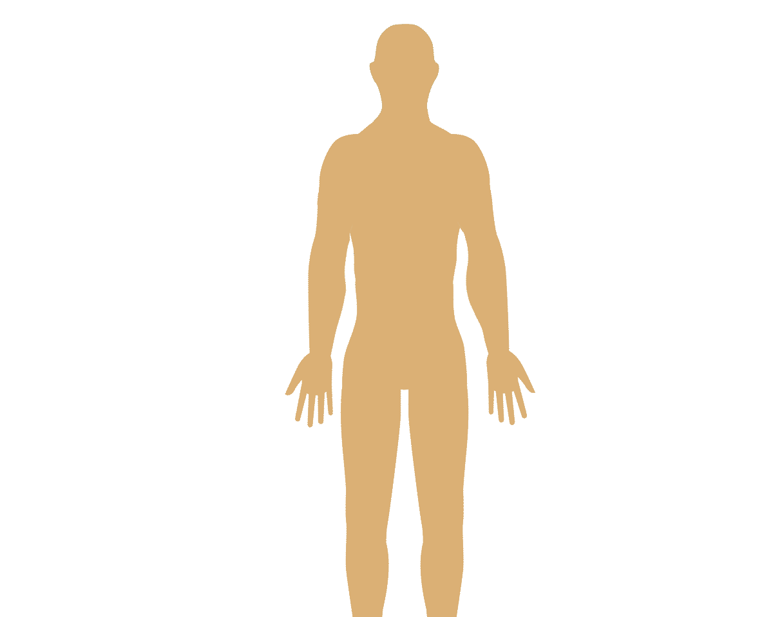
ECG electrode position
R L
RA
LA
LL (Can also be placed on the left abdomen or left foot)

Slide 15
生醫量測系統設計 Design of Biomedical Measurement Systems
LAB 2
Model Training And Validation

Slide 16
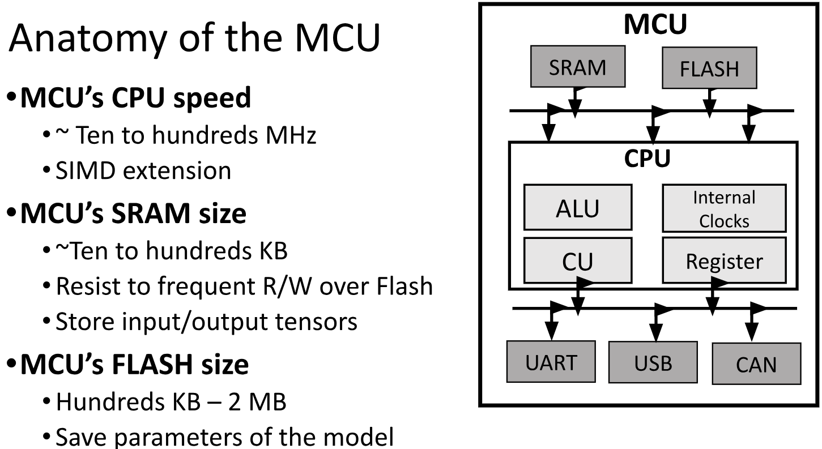

Slide 17
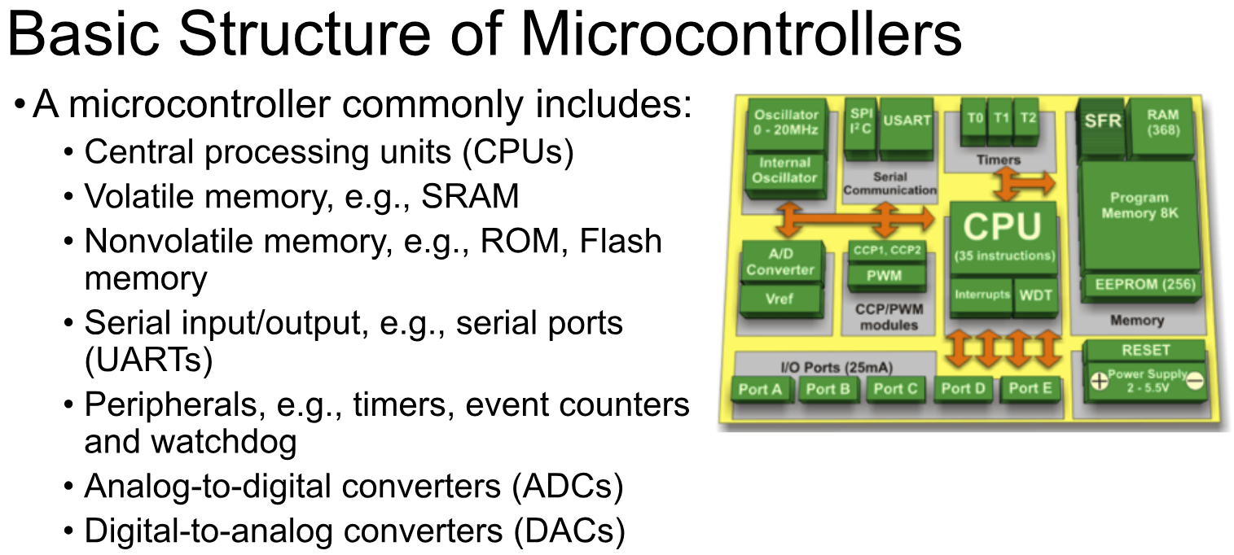

Slide 18
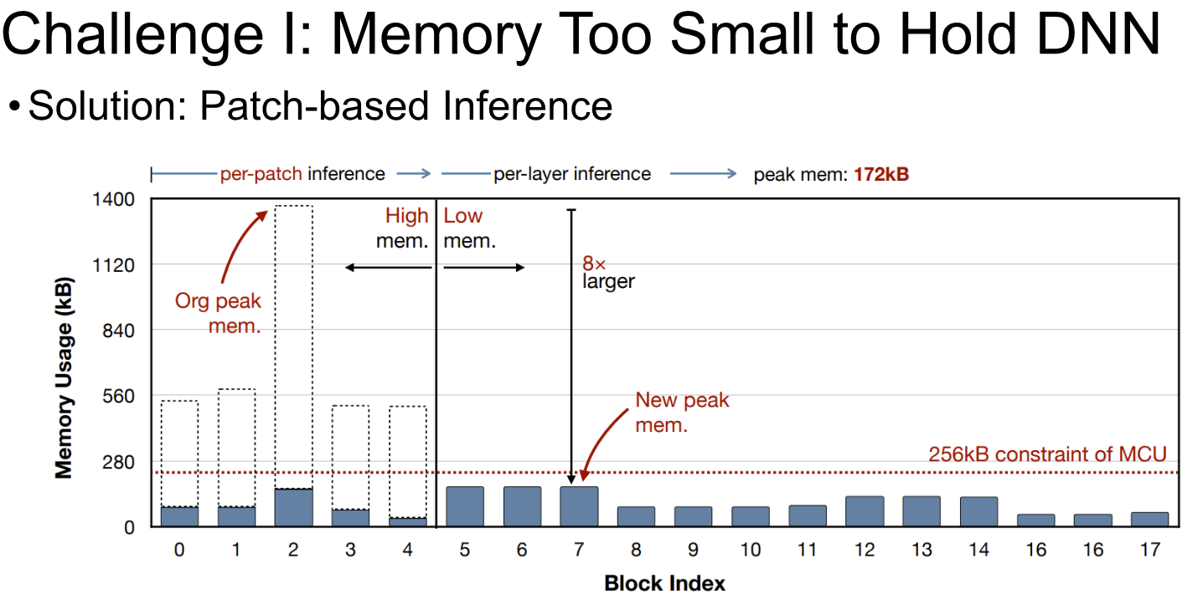

Slide 19
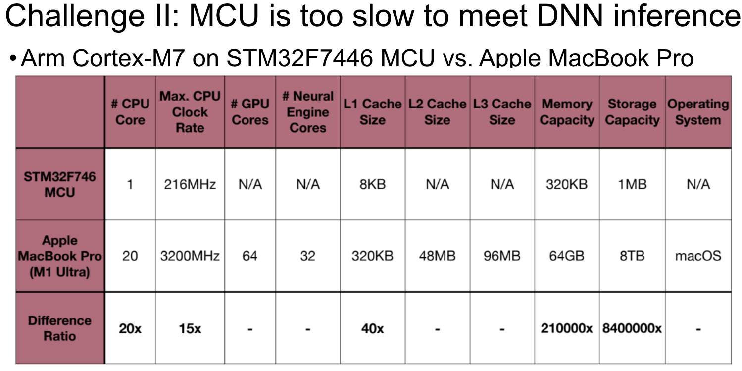

Slide 20
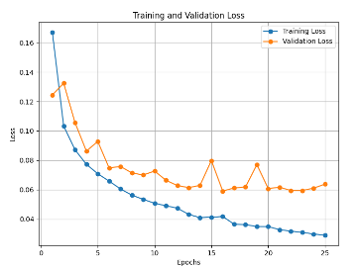
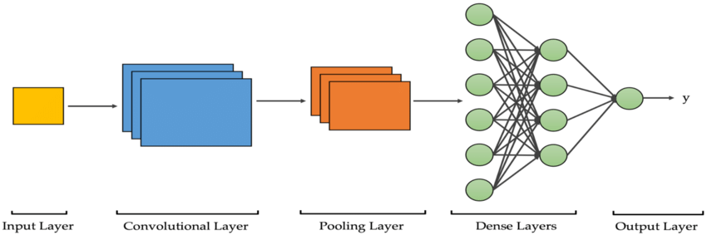
Heart Disease Recognition
Prepare Data
Train Model
Visualization
MIT-BIH Dataset
Cut Data
ECG 1
ECG 1
ECG 2
250
250
250
ECG 1~43 use for training ECG 44 use for inference
ECG 43

Slide 21
Heart Disease Recognition
Prepare Data
Train Model
Visualization
MIT-BIH Dataset
Cut Data
ECG 1
ECG 1
ECG 2
250
250
250
ECG 1~43 use for training ECG 44 use for inference
ECG 43

Slide 22
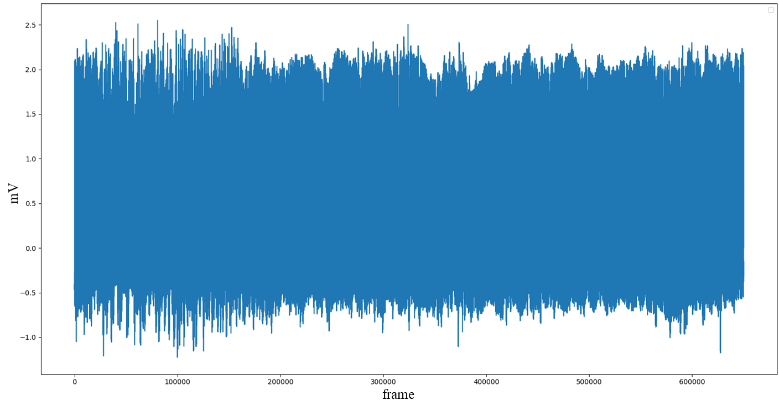
MIT-BIH Arrhythmia Database
The MIT-BIH Arrhythmia Database contains 48 half-hour excerpts of two-channel ambulatory ECG recordings, obtained from 47 subjects studied by the BIH Arrhythmia Laboratory between 1975 and 1979.
The recordings were digitized at 360 samples per second per channel with 11-bit resolution over a 10 mV range. Two or more cardiologists independently annotated each record; disagreements were resolved to obtain the computer-readable reference annotations for each beat (approximately 110,000 annotations in all) included with the database.

Slide 23
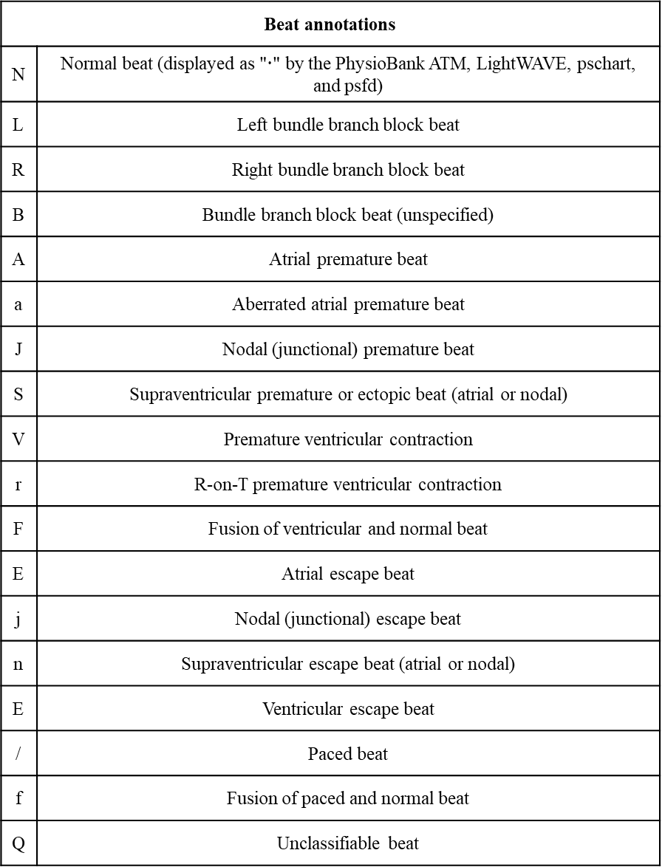
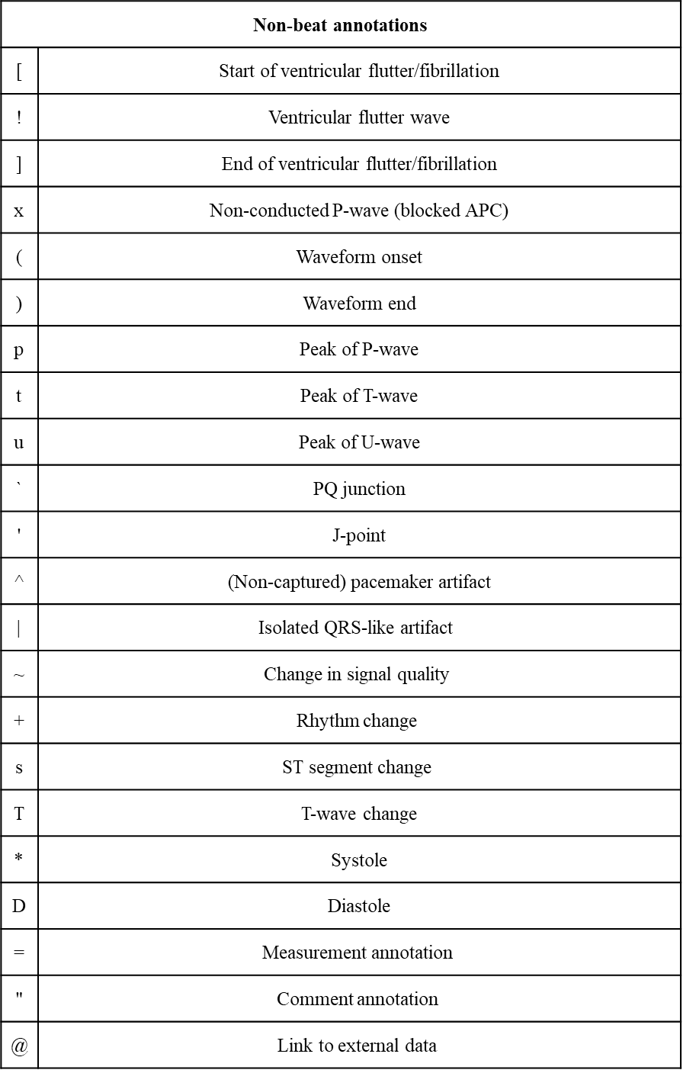
Label & Description

Slide 24
Heart Disease Recognition
Prepare Data
Train Model
Visualization
MIT-BIH Dataset
Cut Data
ECG 1
ECG 1
ECG 2
250
250
250
ECG 1~43 use for training ECG 44 use for inference
ECG 43

Slide 25
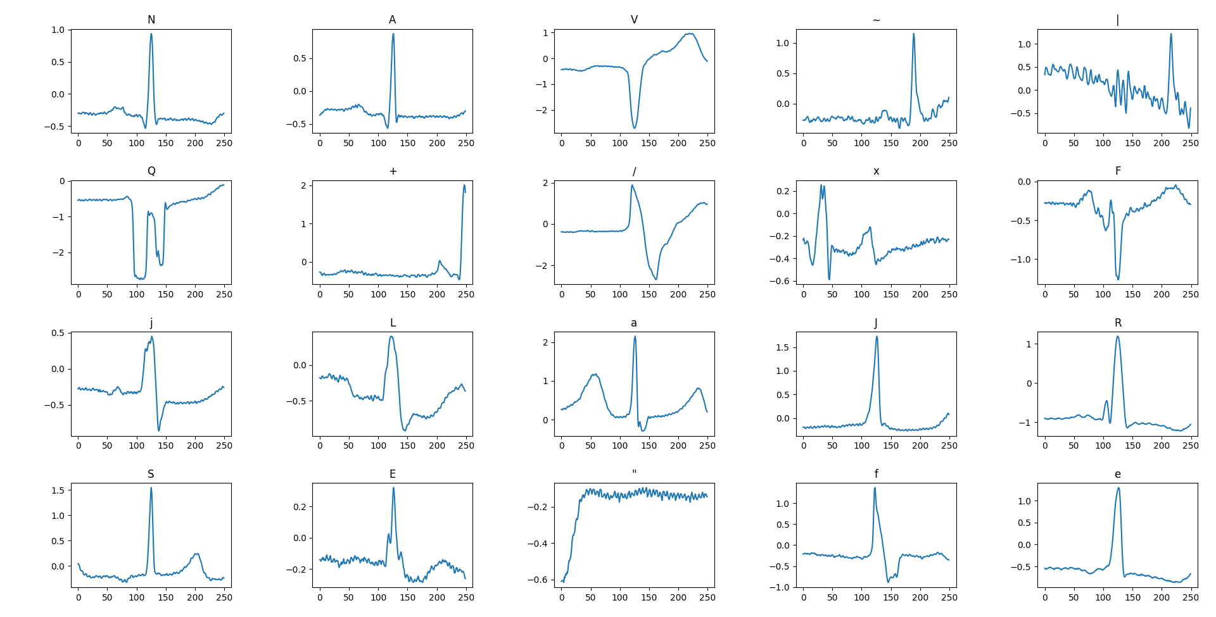
ECG Signal Cutting

Slide 26
Model Training
Prepare Data
Train Model
Visualization
MIT-BIH Dataset
Cut Data
ECG 1
ECG 1
ECG 2
250
250
250
ECG 1~43 use for training ECG 44 use for inference
ECG 43

Slide 27
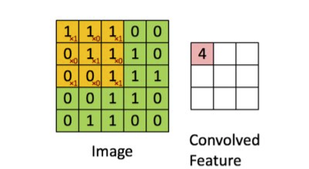
CNN
Convolution: Extracting features from an image by sliding a kernel, with the control of image dimensions through strides and padding.
https://cinnamonaitaiwan.medium.com/%E6%B7%B1%E5%BA%A6%E5%AD%B8%E7%BF%92-cnn%E5%8E%9F%E7%90%86-keras%E5%AF%A6%E7%8F%BE-432fd9ea4935

Slide 28
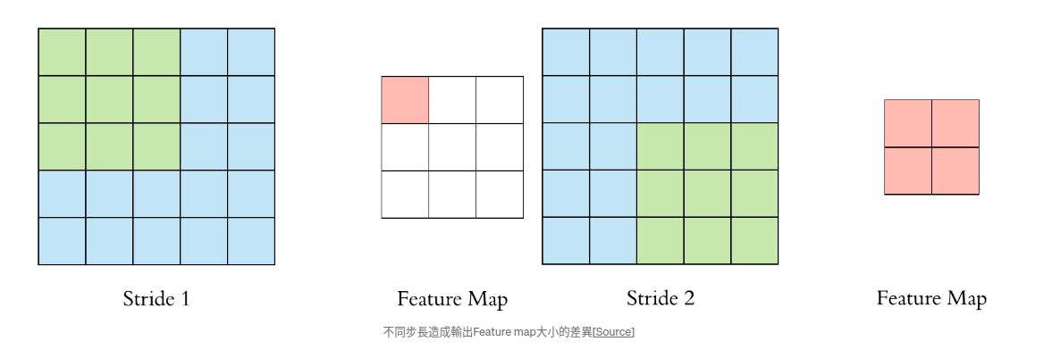
CNN
Different strides result in variations in the output feature map sizes.

Slide 29
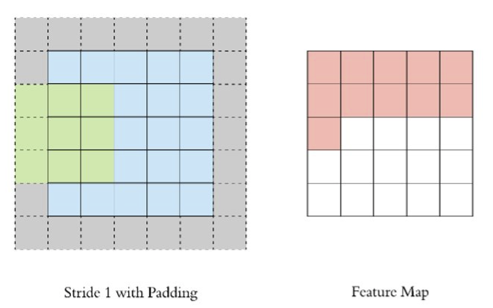
CNN
Padding (Same Padding or Valid Padding):
1. Same Padding will keep the output Feature map and the input image the same size.
2. Valid Padding will not pad the edges, so the Feature map size will decrease.

Slide 30
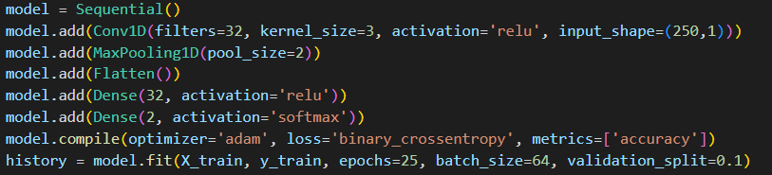
Model Training
Accuracy 95% or more Output Model Size is less than 2MB, otherwise the board will not fit.

Slide 31
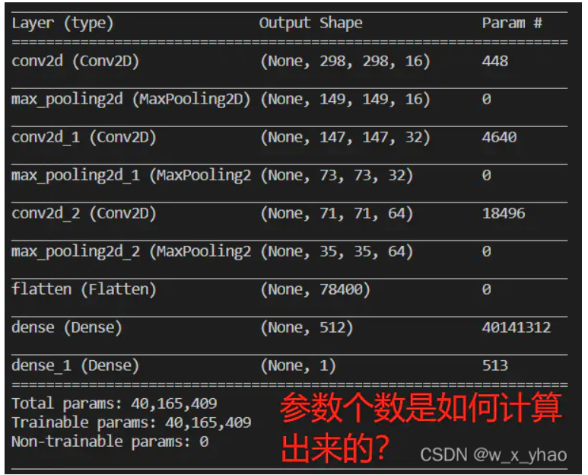
Model Parameters
(3*3*3+1)*16 = 448
(3*3*16+1)*32 = 4640
(3*3*32+1)*64 = 18496
(78400+1)*512 = 40141312
(512+1)*1 = 513

Slide 32
Model Parameters
(3*3*3+1)*16 = 448
(3*3*16+1)*32 = 4640
(3*3*32+1)*64 = 18496
(78400+1)*512 = 40141312
(512+1)*1 = 513
40,165,409
https://blog.csdn.net/qq_41573860/article/details/116767639
https://blog.csdn.net/w_x_yhao/article/details/123050474

Slide 33
Visualization
Train Model
Prepare Data
Visualization
MIT-BIH Dataset
Cut Data
ECG 1
ECG 1
ECG 2
250
250
250
ECG 1~43 use for training ECG 44 use for inference
ECG 43

Slide 34
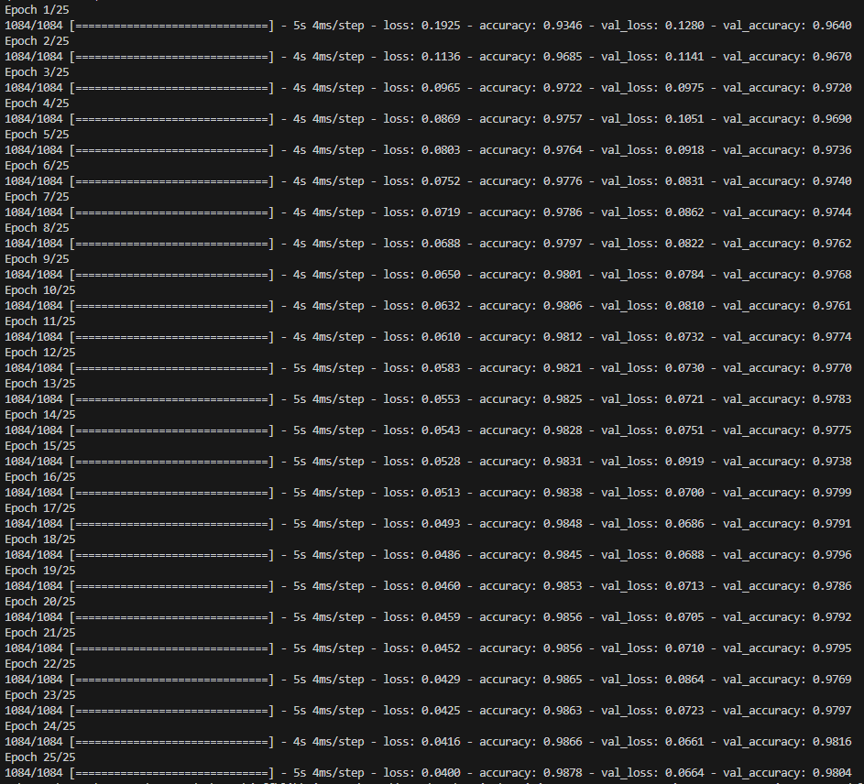
Visualization

Slide 35
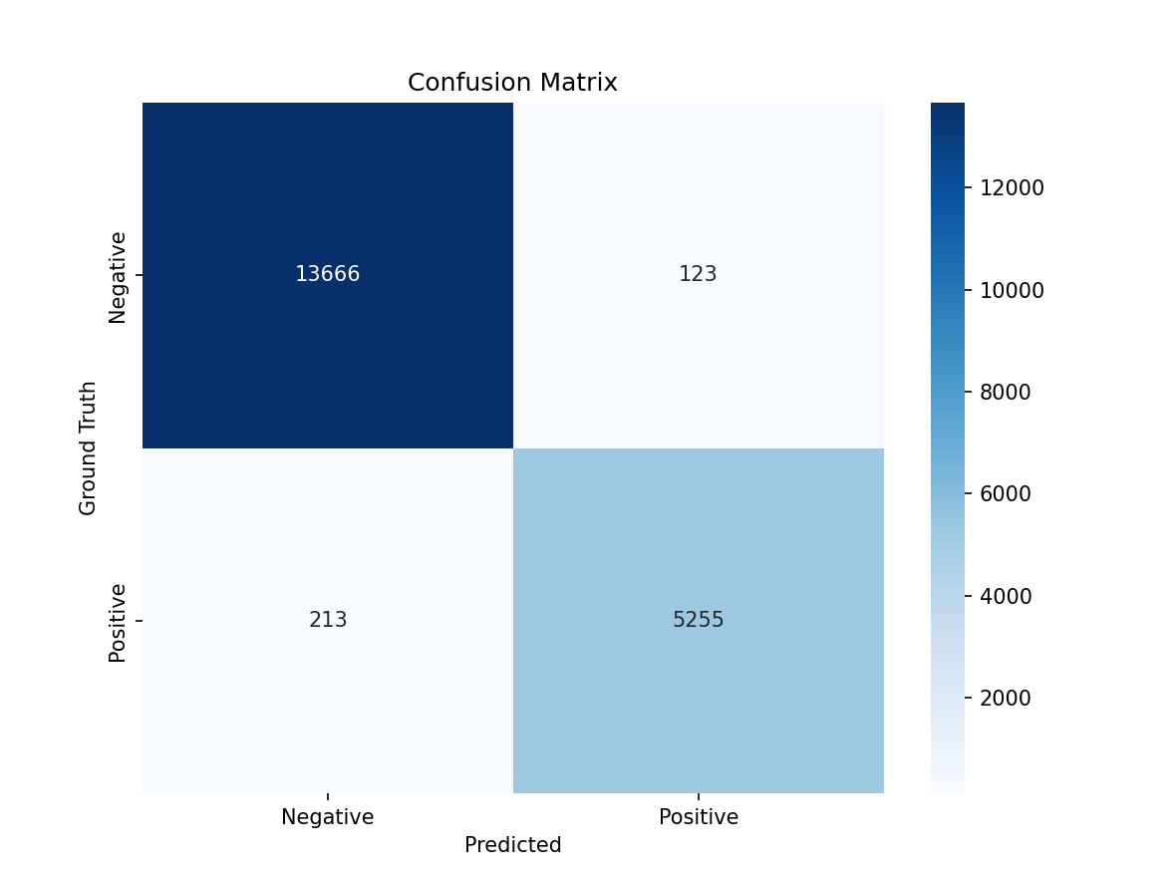
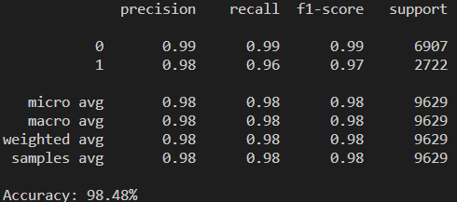
Visualization

Slide 36
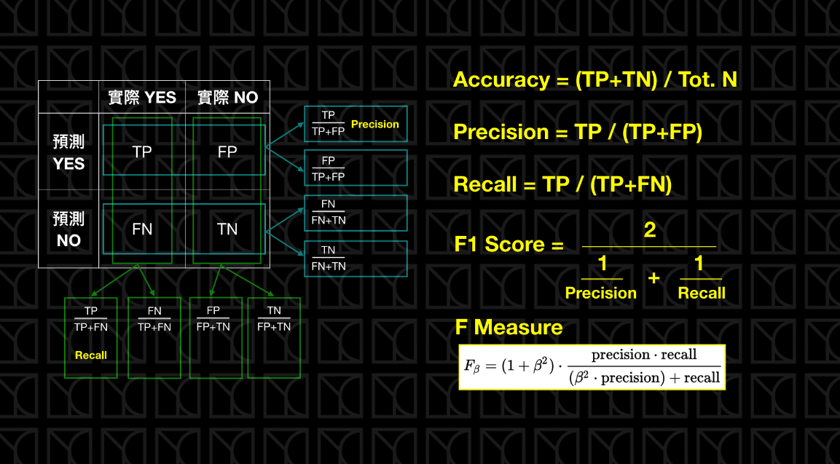
Confusion Matrix
How to identify the quality of a model?
https://www.maxlist.xyz/2022/09/12/confusion-matrix/

Slide 37
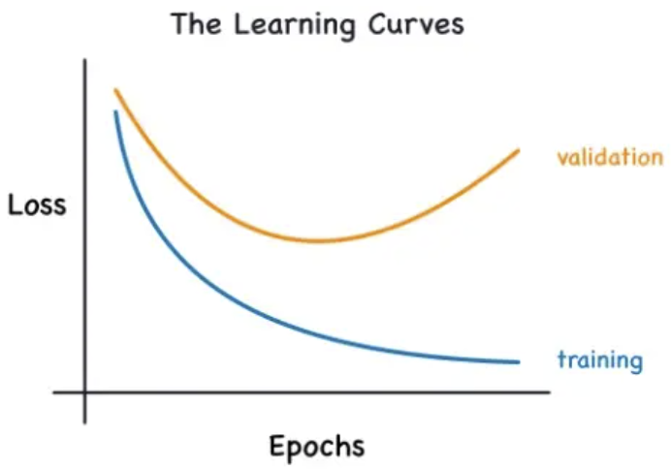
Overfitting
https://ithelp.ithome.com.tw/m/articles/10203371

Slide 38
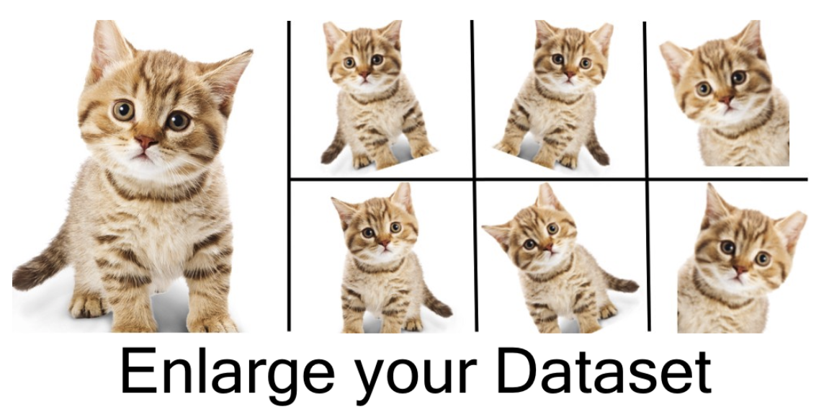
Overfitting
https://ithelp.ithome.com.tw/m/articles/10203371

Slide 39
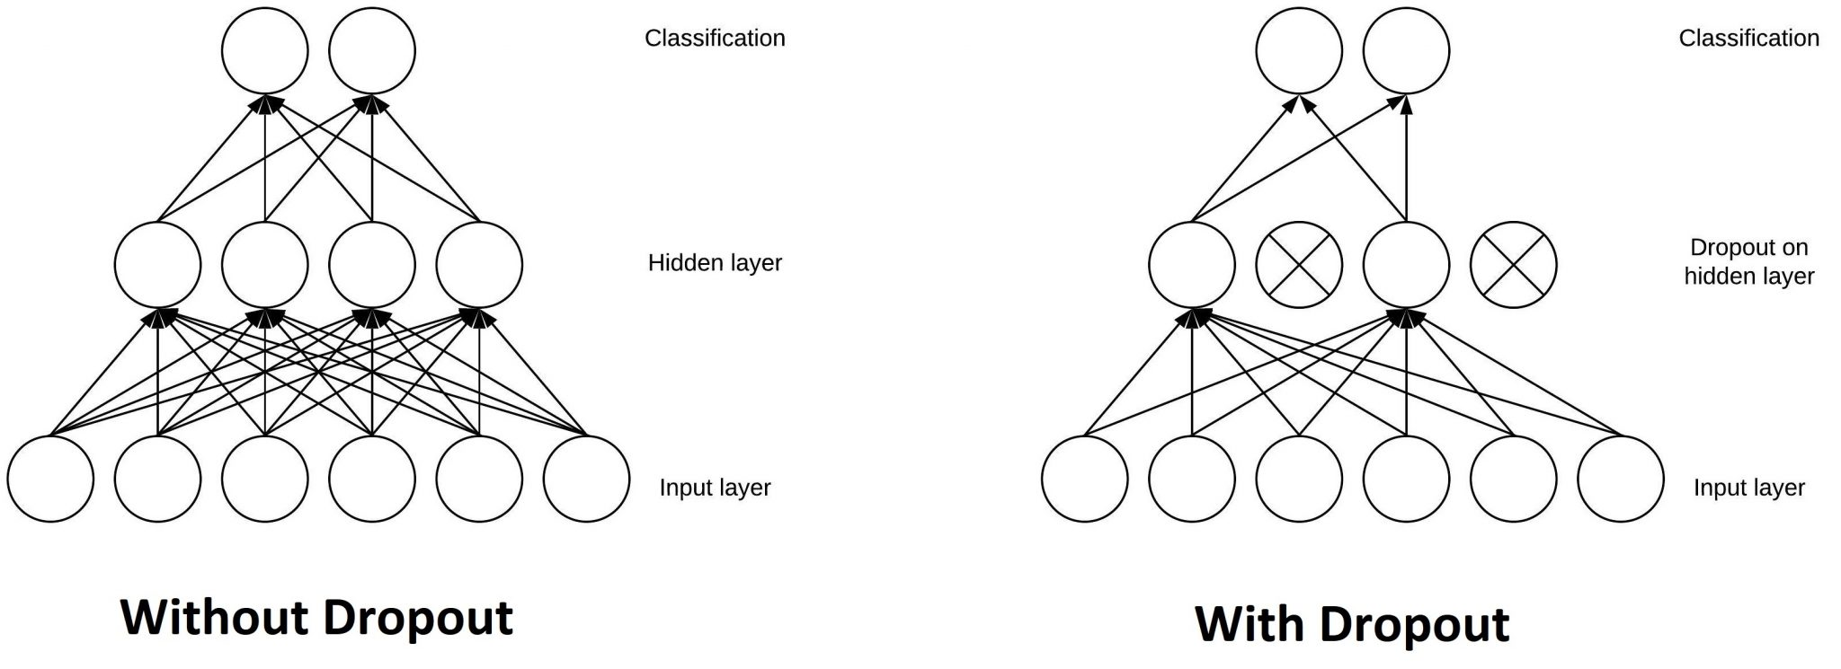
Overfitting
https://wenkangwei.github.io/2020/11/13/DL-DropOut/

Slide 40
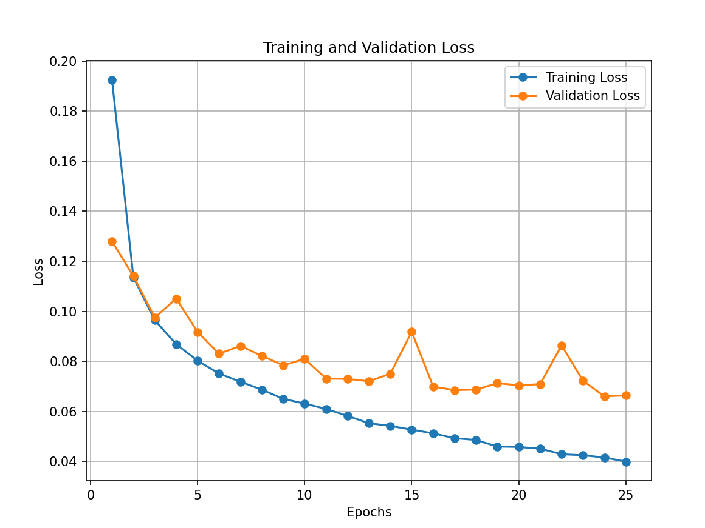
Visualization

Slide 41
生醫量測系統設計 Design of Biomedical Measurement Systems
LAB 3
Convert Model To .tflite

Slide 42
Why TFLite ?
https://ithelp.ithome.com.tw/m/articles/10272501

Slide 43
The library generated through TFLite has a small footprint, which is crucial for smartphones or MCU with limited storage space.
Notes:
通過 TFLite 生成的依賴庫體積很小 (在寸土寸金的手機儲存空間這很重要)

Slide 44
It supports hardware acceleration on mobile devices and can run on both Android and iOS platforms.
Notes:
支援手機端硬體加速

Slide 45
Model is smaller we will show you later.
Notes:
支援手機端硬體加速

Slide 46
Change Model Type
.tflite model is smaller than .h5 model

Slide 47
生醫量測系統設計 Design of Biomedical Measurement Systems
LAB 4
Quantize Model To Smaller Size

Slide 48

STM32cubeIDE
STM32CubeIDE is the official IDE released by STMicroelectronics for STM32 development. It combines features such as development board selection, program coding, compilation, and flashing, eliminating the need for switching between software and configuring environments.

Slide 49
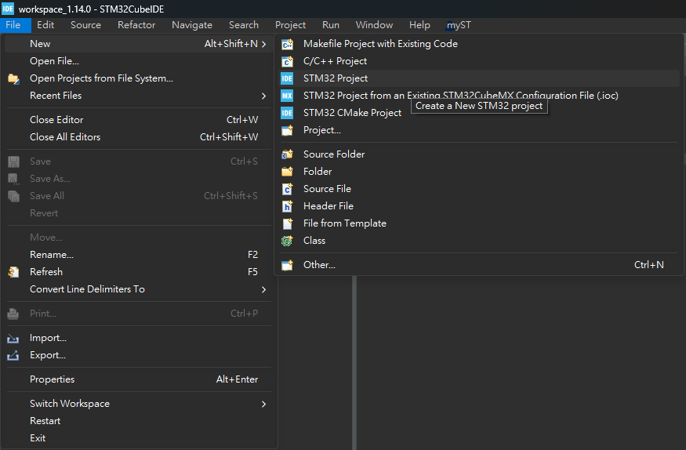
Create STM32 Project

Slide 50
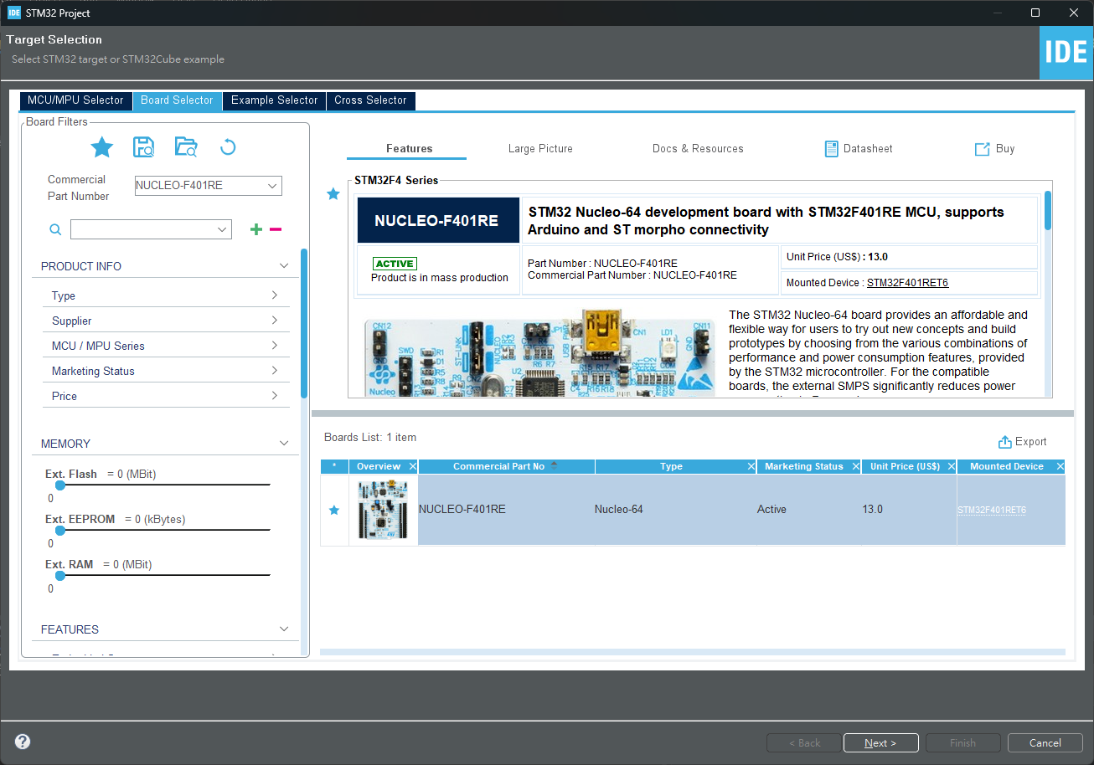
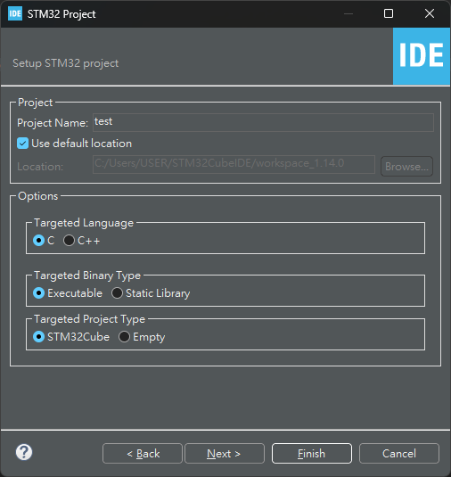
Create STM32 Project

Slide 51
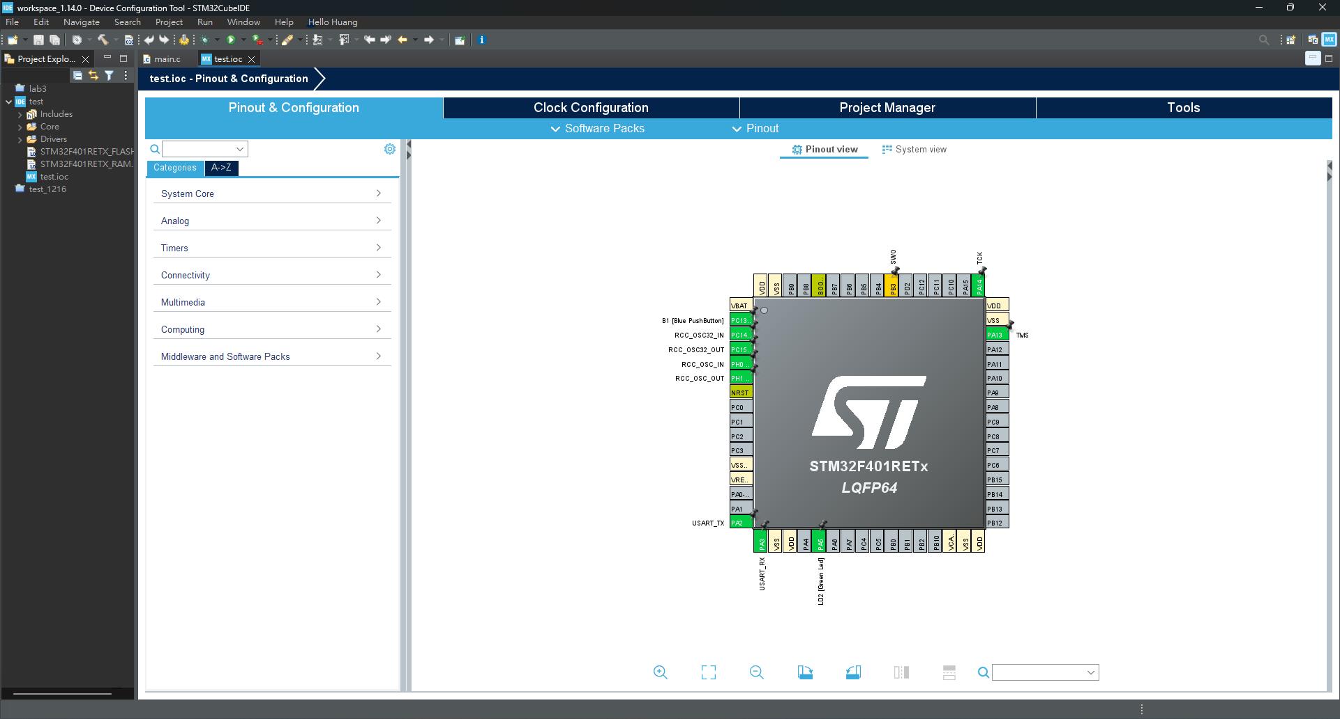
Create STM32 Project
Notes:
左邊是IDE編譯器，自動產生的底板程式碼，
右邊是CUBEMX軟體介面，可對開發板硬體資源進行設定。

Slide 52
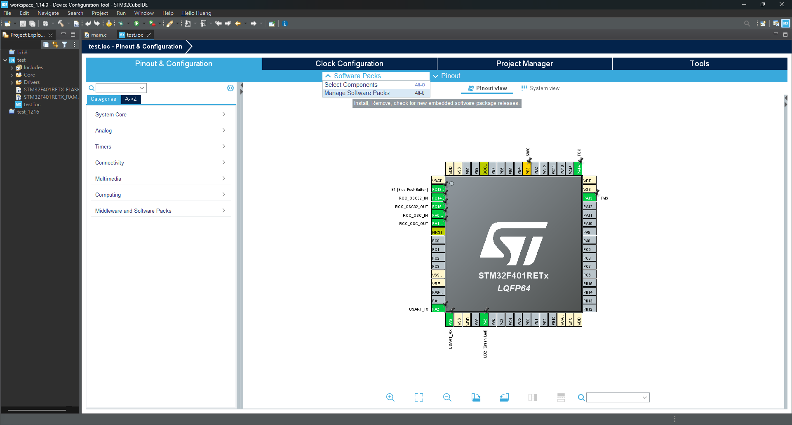
Install X-CUBE-AI
Notes:
下載AI開發所需的software packs

Slide 53
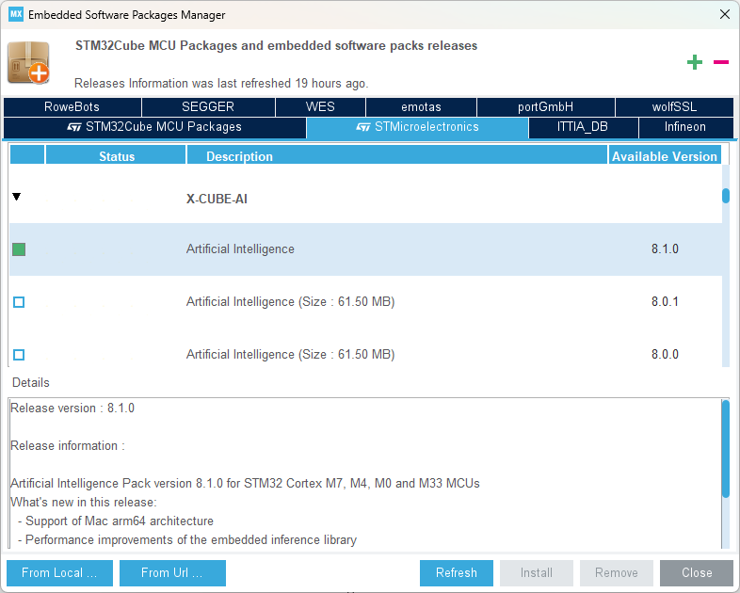
Install X-CUBE-AI

Slide 54
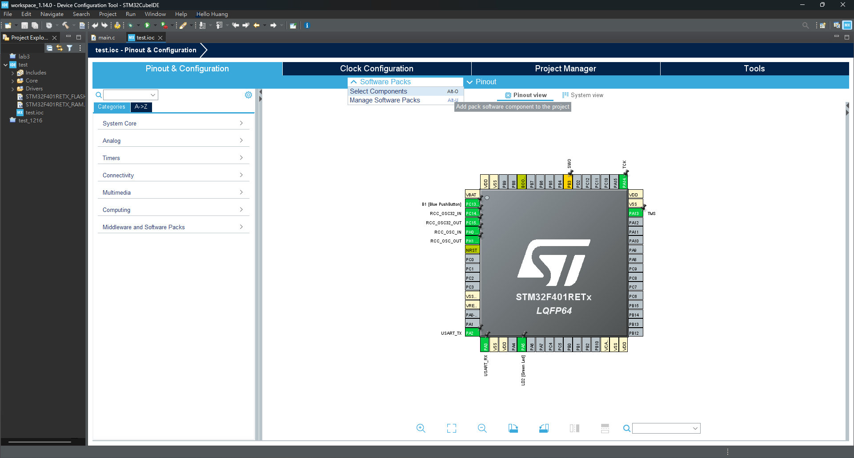
Select X-CUBE-AI

Slide 55
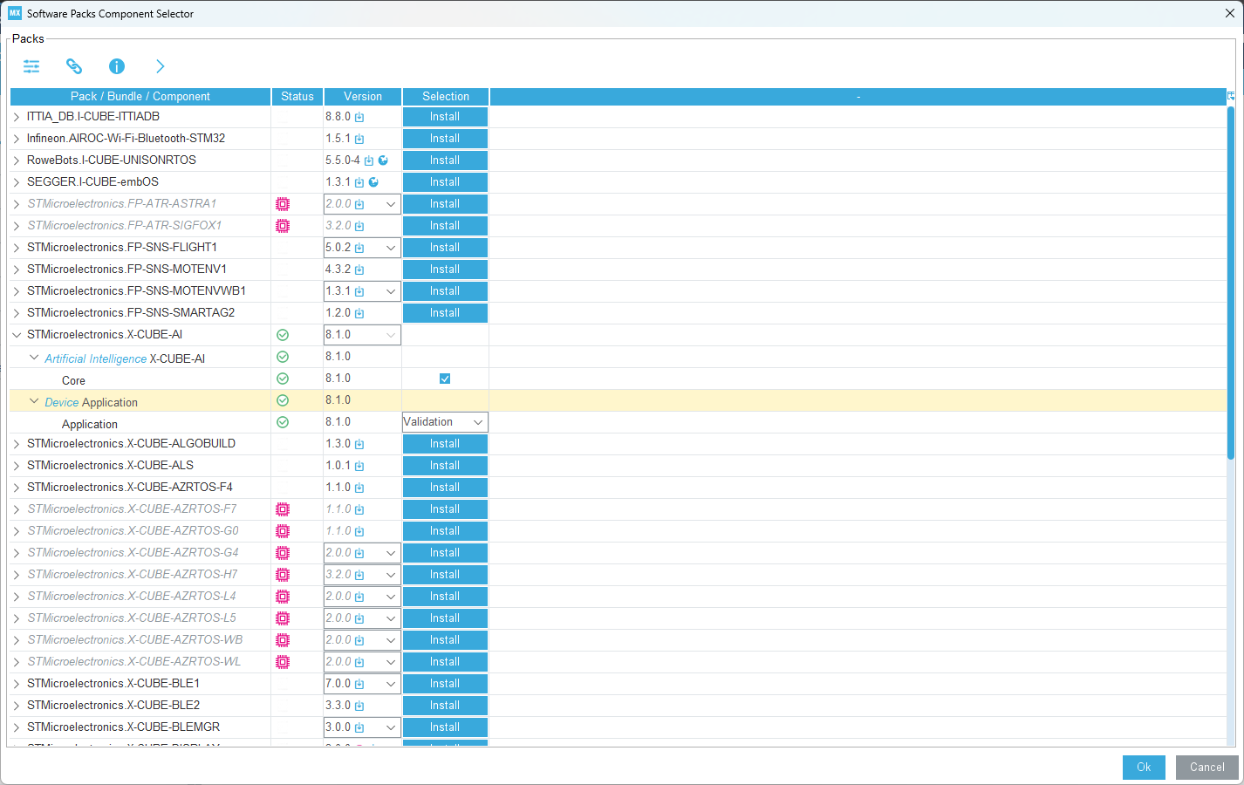
Select X-CUBE-AI

Slide 56
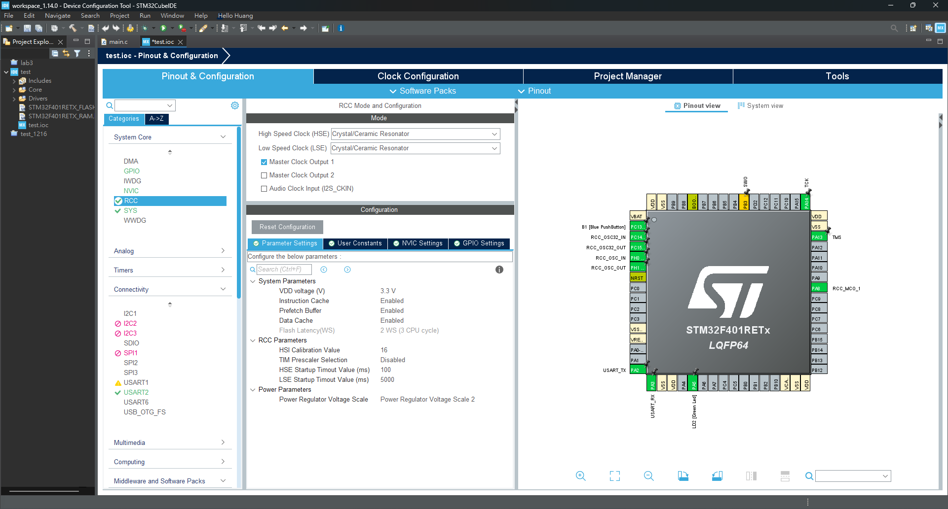
Reset and clock control (RCC)
Notes:
RCC 的完整英文描述是 ，Reset and clock control，重置(system, power, and backup reset)與時脈控制。
高速外部時脈訊號 (HSE)
低速外部時脈訊號 (LSE)
Crystal/Ceramic Resonator（石英/陶瓷 晶振）

Slide 57
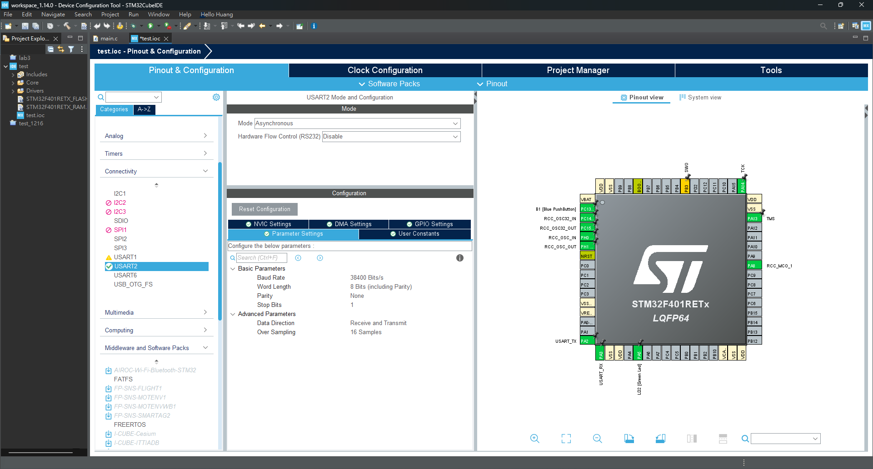
UART

Slide 58
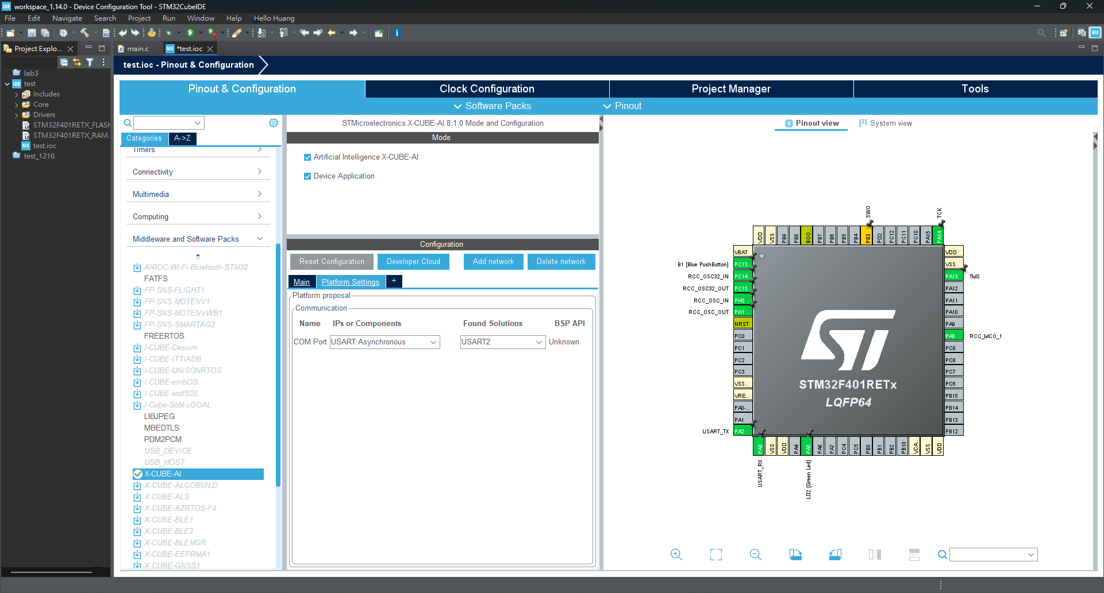
UART

Slide 59
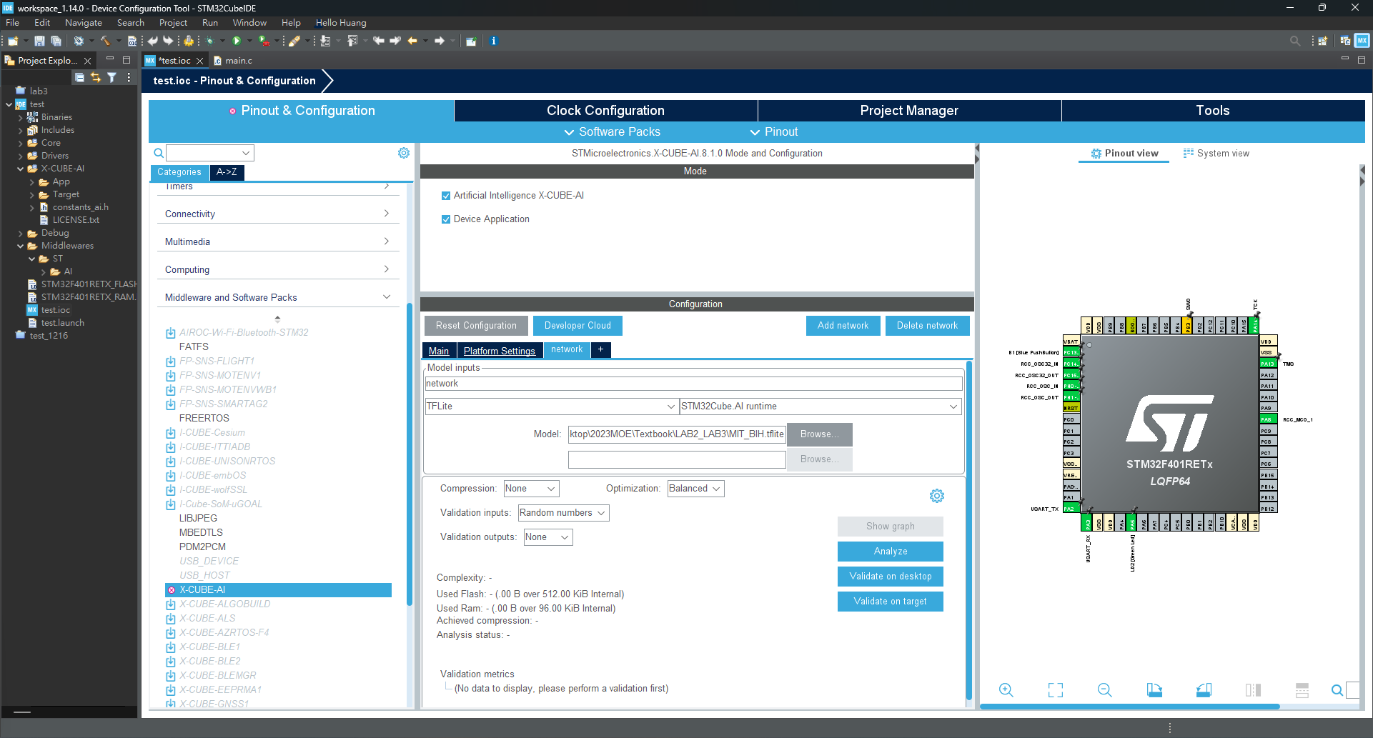
Add Network and Analyze

Slide 60
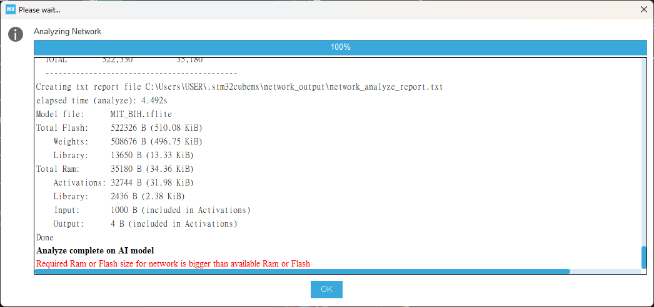
Add Network and Analyze

Slide 61
Model Quantization
Model quantization is an optimization technique for deep learning models aimed at reducing storage space and computational resources while preserving predictive performance.
Notes:
模型量化（Model Quantization）是一種深度學習模型優化技術，旨在減少模型佔用的存儲空間和計算資源，同時保持模型的預測性能。

Slide 62
Model Quantization
The primary principle of this technique involves reducing the precision of weights and activation values in the model, typically converting them from floating-point numbers to lower-bit integer representations.
Notes:
這種技術的主要原理是減少模型中權重和激活值的位數，通常是由浮點數轉換為更低位數的整數表示。

Slide 63
Model Quantization
Weight Quantization: Transformed from floating-point numbers to integer representations. This transformation often uses lower-bit integers, such as 8-bit or 16-bit integers.
Notes:
在模型量化中，通常將原始模型中的浮點數權重轉換為整數表示。這種轉換通常使用較低位數的整數，例如8位或16位整數。這樣的轉換減少了權重的存儲需求，同時仍然可以保持模型的相對性能。

Slide 64
Model Quantization
Quantization during Training and Dequantization during Inference: This is done to realize the benefits of quantization during training while not compromising the predictive performance of the model during inference.
Notes:
在訓練過程中，模型權重和激活值被量化為較低位數的整數。但在實際推理（預測）過程中，通常仍然使用浮點數進行計算。這樣做是為了在訓練時實現量化的好處，同時在推理時不損失模型的預測性能。

Slide 65
Model Quantization
Hardware Support: Some hardware, such as specific GPUs, TPUs, or DSPs, can efficiently handle integer operations. This further enhances the benefits of model quantization, leading to faster inference speeds on hardware.
Notes:
硬體支援： 一些硬體（如特定的GPU、TPU或DSP）能夠更有效地處理整數運算，這進一步提高了模型量化的效益，使得在硬體上的推理速度更快。

Slide 66
Representative Data
A subset of data that accurately reflects the characteristics and distribution of the overall dataset.
Notes:
是指一個數據集的子集，能夠準確反映整體數據集的特徵和分佈

Slide 67
Representative Data
When working with large datasets, it may be computationally expensive. In such cases, a representative sample or subset of the data is selected to stand in for the entire dataset.
Notes:
在處理大型數據集時，使用整個數據集進行各種任務，如模型訓練、驗證或測試，可能會計算上昂貴或不切實際。在這種情況下，選擇一個代表性的樣本或子集來代表整個數據集。

Slide 68
Representative Data
In tools like TensorFlow Lite, it is common practice to use a representative dataset for model quantization. By using such a representative dataset, it can be ensured that the quantized model better retains its predictive capabilities during the conversion process.
Notes:
在 TensorFlow Lite 等工具中，常見的做法是使用代表性數據集合（representative dataset）來量化模型。這個數據集合包含了一些特定於應用的樣本，這些樣本可以代表模型在部署時將要處理的數據。透過這樣的代表性數據集合，可以確保量化模型在轉換過程中更好地保留其預測能力。

Slide 69
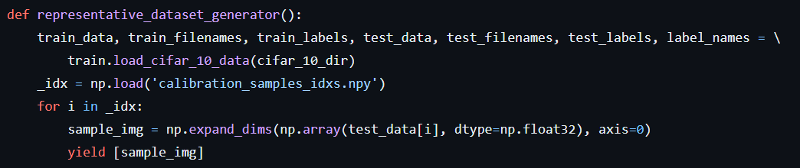
Representative Data

Slide 70
Shrink Model
Use quantized method can shrink .tflite model

Slide 71
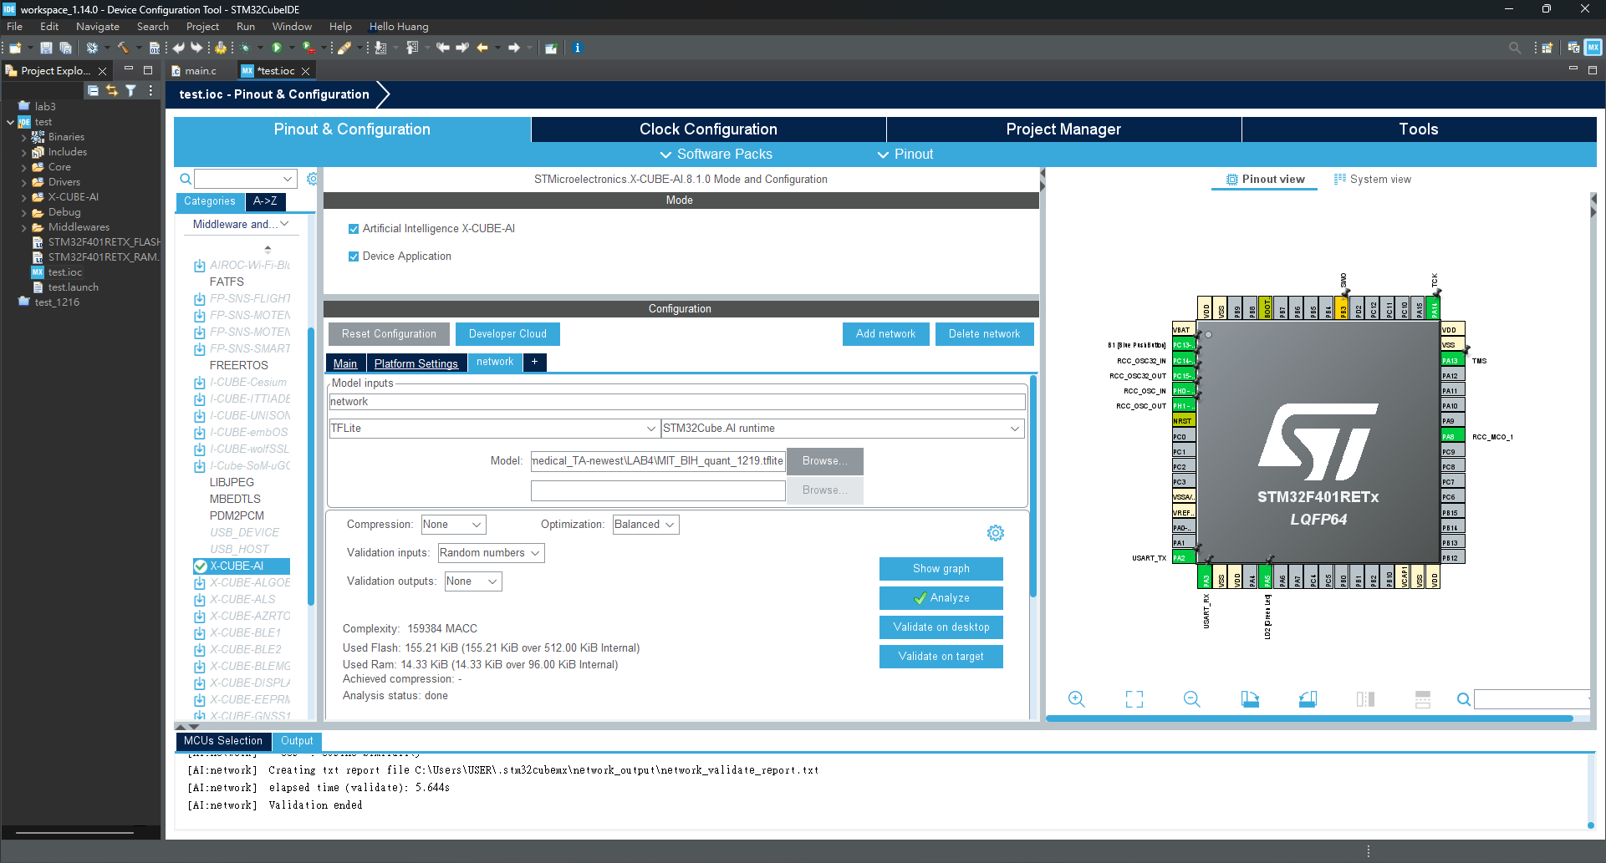
Change Model and Analyze

Slide 72
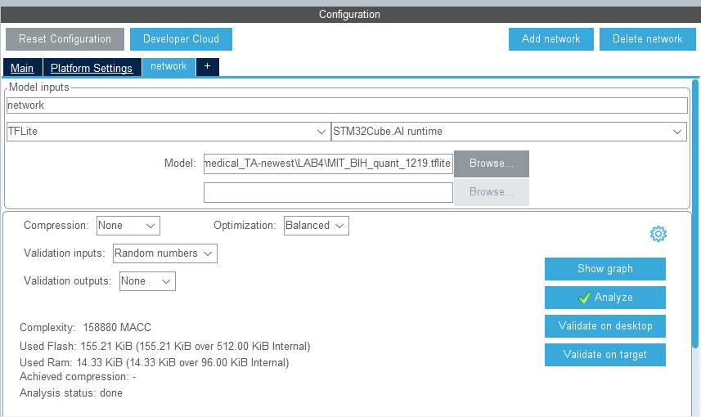
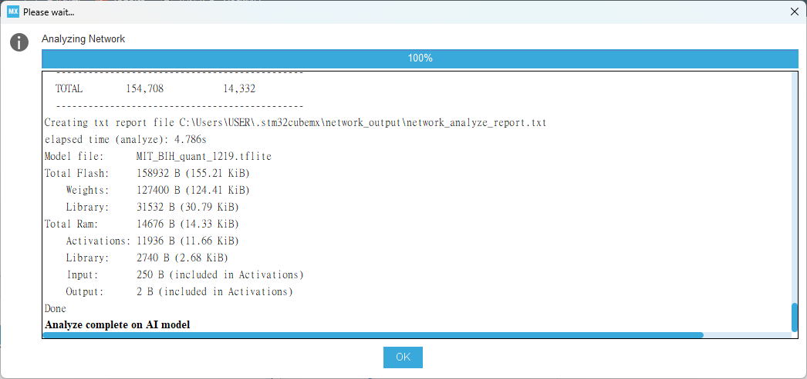
Analyze Output
The tool will infer the model's resource occupancy (ROM, RAM) based on the model and model parameters, allowing an assessment of whether the model can be deployed to a development board.

Slide 73

Validation on desktop
The verification data is the testx.npy and testy.npy files we just specified.

Slide 74

Validation on desktop
To verify the training model, we mainly verify the differences in computing resources, model accuracy, etc. before and after the verification between the original model and the model converted to C language support.
Notes:
沒有Accuracy 是因為我們範例使用的模型不是分類模型是回歸模型

Slide 75


Generate Code

Slide 76

Build Project

Slide 77

Build Project

Slide 78


Build Project

Slide 79
Validation on target
The verification data is the testx.npy and testy.npy files we just specified.

Slide 80

Validation on target
The model is successfully verified on the target board.

